Slide 1
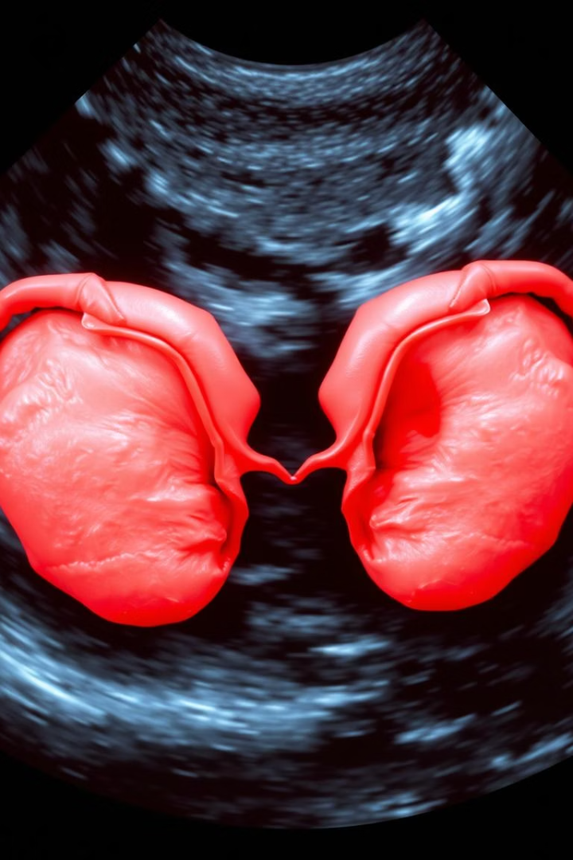


A Hybrid CNN-LSTM Deep Learning Model for Automated Diagnosis of Polycystic Ovary Syndrome from Ultrasound Images
We Arnav Vats manan malik from Bennett University present a novel approach to PCOS diagnosis. Their hybrid CNN-LSTM model leverages deep learning for automated analysis of ultrasound images. This research aims to improve diagnostic accuracy and efficiency.

Slide 2


Introduction: The Challenge of PCOS Diagnosis
Polycystic Ovary Syndrome (PCOS) affects many women's health. Current diagnosis relies on manual ultrasound interpretation. This process is subjective and has limitations.
The Problem
Our solution
Manual interpretation is time-consuming
An automated CNN-LSTM model can aid in diagnosis. It can offer consistent and objective results.
It is subject to inter-observer variability
There is a need for automation

Slide 3



Research Objectives and Contributions
1
Automated PCOS Detection
2
Hybrid CNN-LSTM Model
Develop a deep learning model for automated PCOS detection.
Combine CNNs and LSTMs for feature extraction and sequence modeling.
3
Benchmark Against Datasets
Evaluate the model on real-world ultrasound datasets.
This model introduces a novel approach combining CNNs and LSTMs. Improved diagnostic accuracy is achieved over traditional methods. Dataset diversity and interpretability are key considerations.

Slide 4

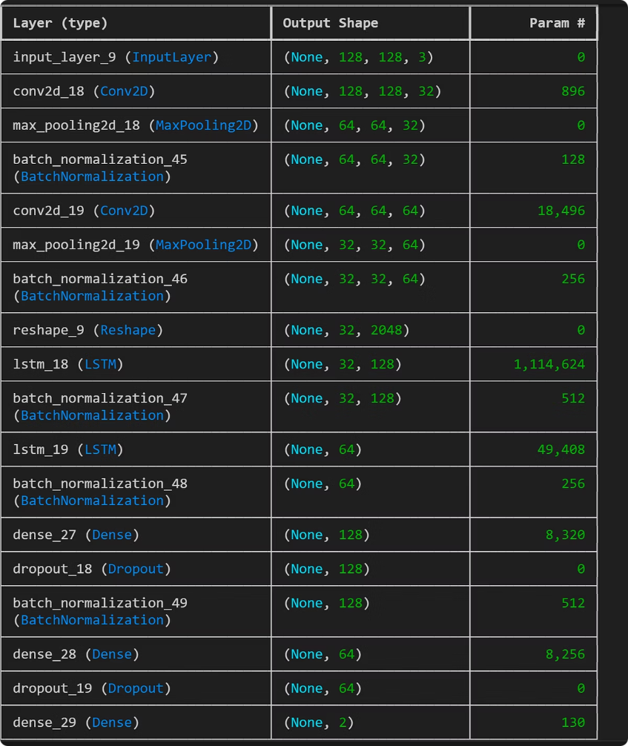




Proposed Methodology: System Description
CNN: Feature Extraction
Extracts key image features.
LSTM: Sequence Modeling
Models data over time.
Hybrid Architecture
Combines CNN and LSTM for analysis.
This model uses CNNs to extract features and LSTMs to recognize patterns. It leverages both convolutional layers and temporal modeling.

Slide 5
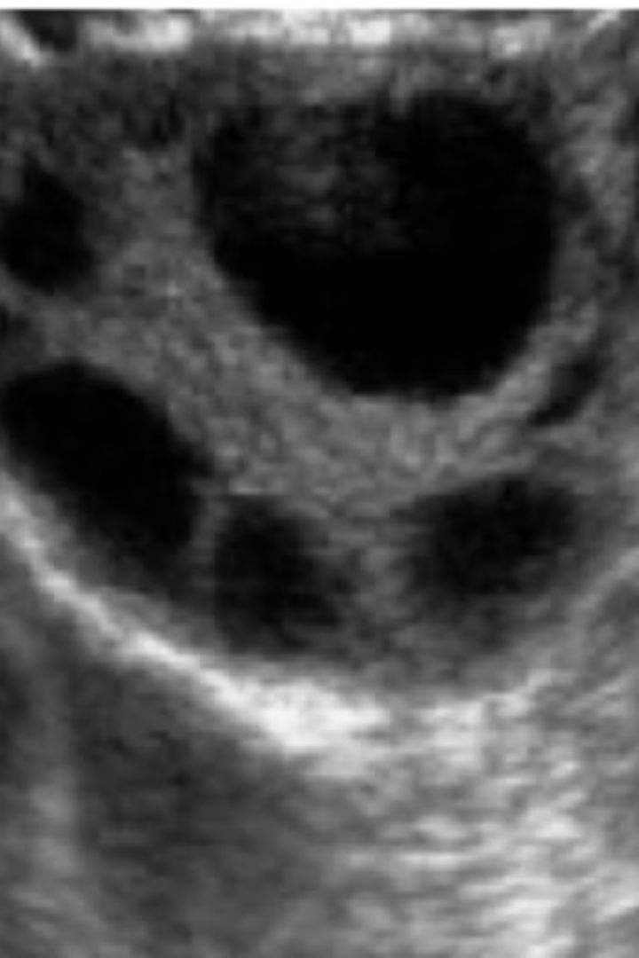


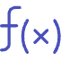



Technical Details and Experimental Setup
Input
Augmentation
Loss
128x128 pixel ultrasound images.
Random rotation, horizontal flips, brightness adjustment.
Binary Cross-Entropy.
Optimizer
Adam (learning rate: 1e-4).
The model was trained for 100 epochs with early stopping. An Nvidia T4 GPU on Google Colab was used.

Slide 6
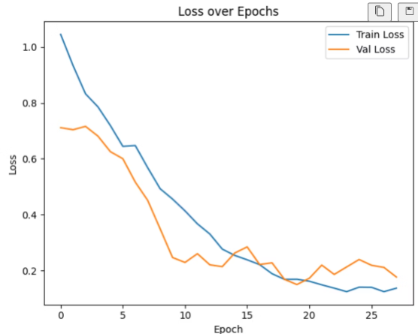
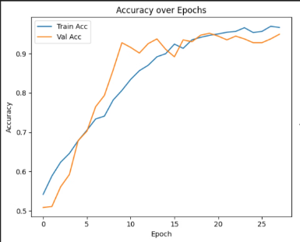

Results and Discussion
98.33%
97%
Accuracy
Precision
Correctly identifies PCOS cases
Correct when predicting PCOS
99%
98%
Recall
F1-Score
Identifies actual PCOS cases
Balanced performance measure
The CNN-LSTM model demonstrates superior performance compared to a simple CNN or VGG16, with stable training and validation curves.

Slide 7
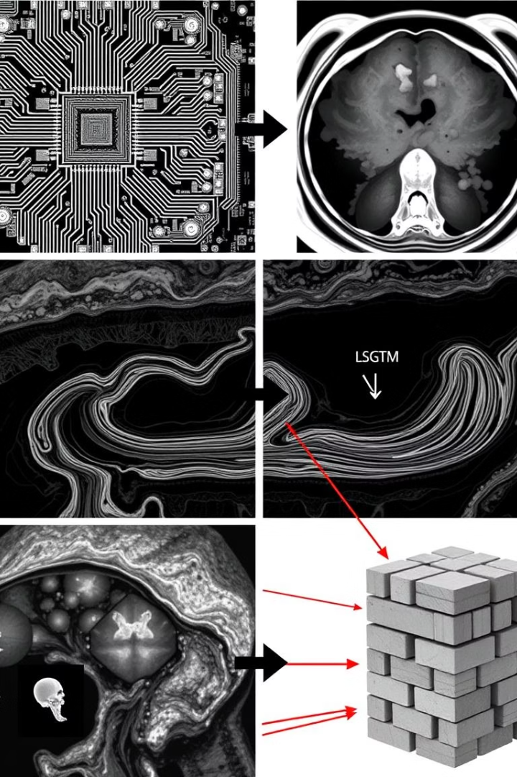
Comparative Analysis and Key Findings
Outperforms others
CNN-LSTM model excels in accuracy, precision, and F1-score.
Spatial and temporal
Combines spatial and sequential modeling.
Imaging noise
Robust due to data augmentation.
Combining spatial feature extraction with sequential modeling enhances accuracy. Data augmentation improves resilience to imaging noise.
Model
Accuracy
Precision
Recall
F1-Score
Simple-CNN model
97.22%
95%
99%
97%
Proposed CNN-LSTM
98.33%
97%
99%
98%

Slide 8


Conclusion and Future Work
Summary
Limitations
Future Work
CNN-LSTM model achieved 98.33% validation accuracy and 99.281% test accuracy.
Dataset size and absence of longitudinal data.
Train with 3D ultrasound data
Incorporate attention mechanisms
Explore multi-modal fusion
AI-driven solutions enhance clinical diagnosis and improve accessibility. Future work includes 3D ultrasound data and attention mechanisms.

Slide 9



We appreciate your attention and interest in our presentation.

